Slide 1


Slide 2

Real World Learning Network
To explore and share successful approaches to Real World Learning through the outdoor classroom that leads to action for sustainable development.

Slide 3

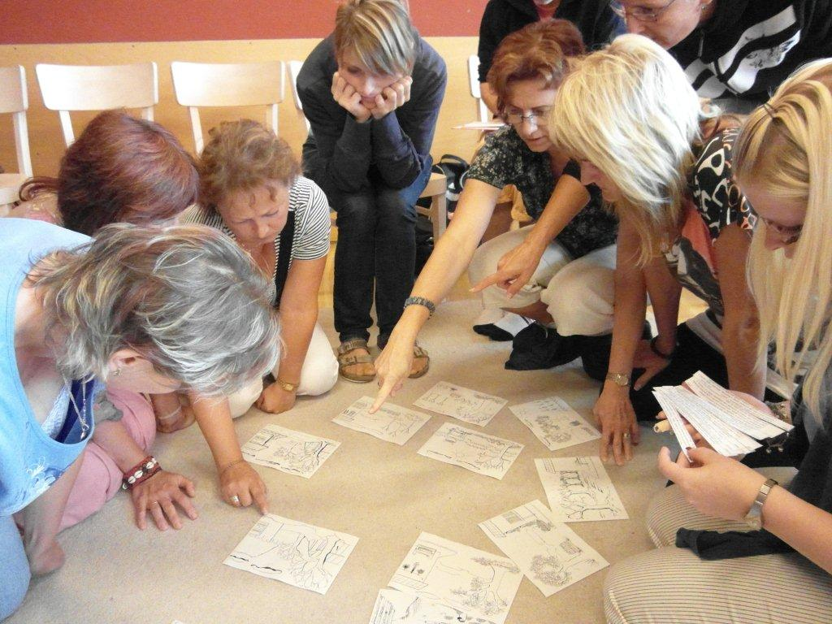
What quality criteria exist? How are they used?
What quality criteria should we have?
How can we assess competencies and behaviour change?
What needs to change?

Slide 4
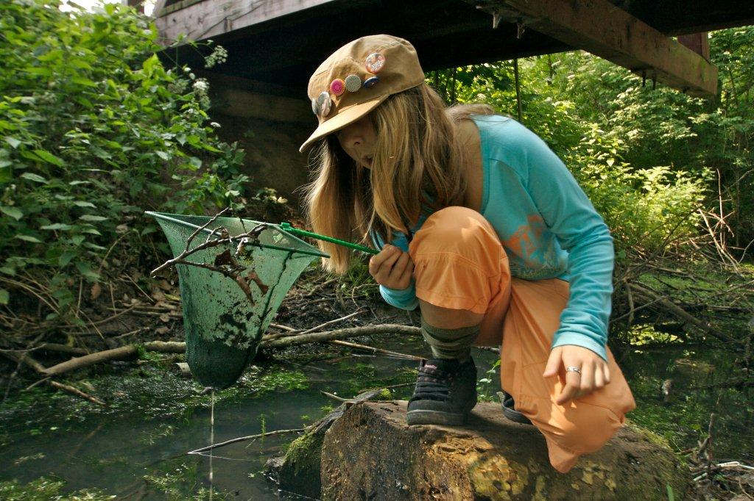
Which scientific concepts support sustainable thinking, competencies and behaviours?
How can science support sustainable behaviour change?
How can outdoor learning deliver?

Slide 5
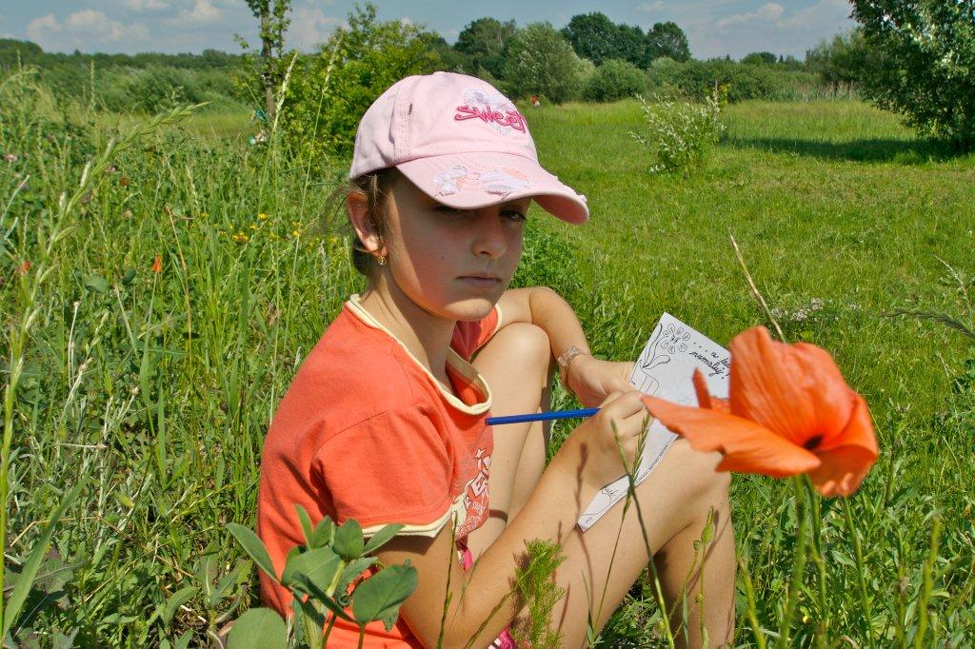
How should we teach science?
Are there better ways to develop competencies for sustainability?
Are we changing behaviours?

Slide 6
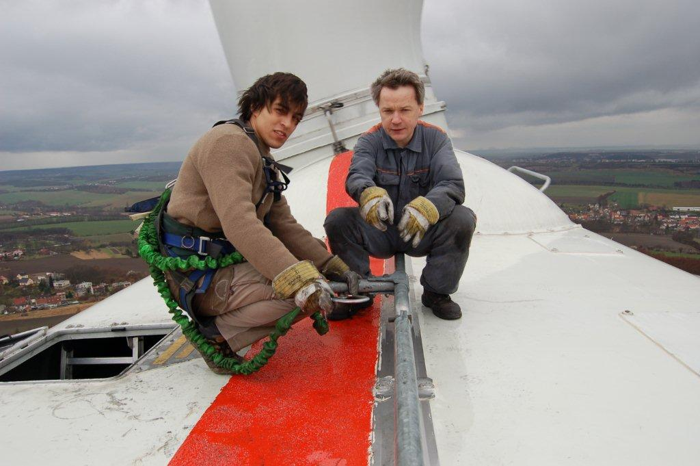
How do we prepare pupils for future careers?
What competencies might they need?
What values underpin the competencies?
How can outdoor learning deliver these?

Slide 7
Why the Network?
Need better responses to sustainable development
Reduced fieldwork in teacher training
Decline in science connected to real world
Too much knowledge based learning
Lack of quality assessment in outdoor learning
Limited professional support to outdoor educators
No effective European forum

Slide 8
Working Groups
2. Outdoor Science and Sustainability
1. Quality Criteria and Assessment for Learning
3. Pedagogical Approaches to Outdoor Learning
4. RWL and Developing Career Competencies

Slide 9
How does this benefit me?
Critical Thinking
Challenge
Reflective Practice
Real World Learning
Embedding ESD
Big Science Concepts
Assessing Learning

Slide 10
RWL Network
Ambition to create and grow a network of Real World Learning practitioners across Europe.
Seven members of consortium
Aim to grow network by at least 10 members each year
Agree formal network by end of project
Virtual and physical network established

Slide 11
Getting Involved
Contributing to Working Groups (2012-2013)
Attending European RWL Seminars (1 per year)
Contributing good practice case studies (ongoing)
Developing new partnerships (ongoing)
Promoting your message (ongoing)
Linking initiative (ongoing)
Other...

Slide 12
What do you want to learn more?
Become a member

